Slide 1

Smart Disaster Evacuation Route Planner
CSA0624 - DESIGN AND ANALYSIS OF ALGORITHMS
Guided by: Dr. Gnanajeyaraman
Presented by: Ganji Madhan Kumar(192472328) P.Karthik(192524222)
M.Teja(1924….)

Slide 2
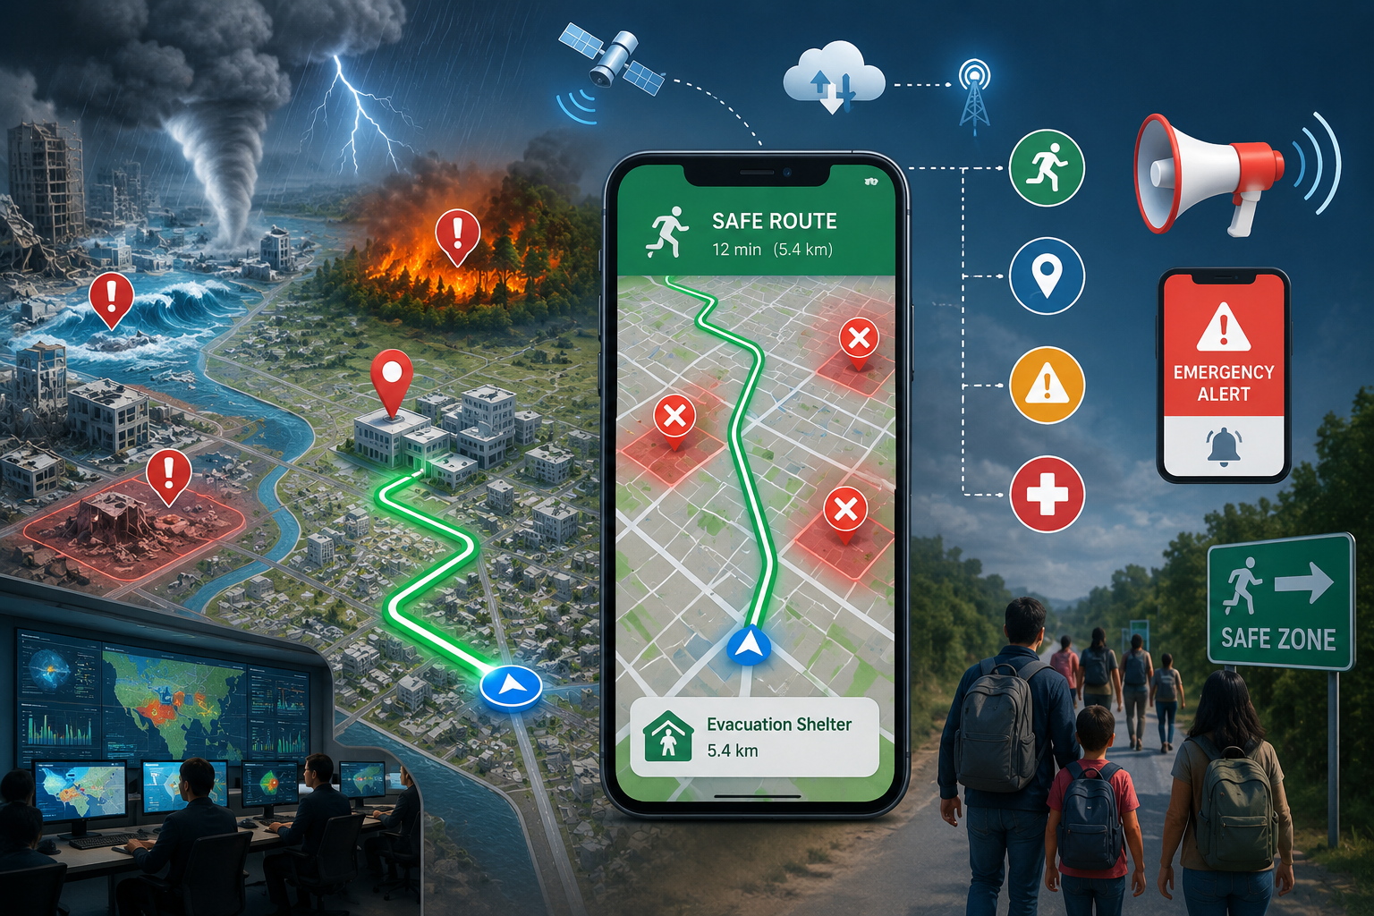
Introduction
A smart system for finding safe evacuation routes during disasters.
Uses AI, maps, and real-time data to analyze dangerous areas.
Helps people choose the safest and fastest route to an emergency shelter.
Avoids blocked roads and high-risk zones during evacuation.
Provides route guidance and emergency alerts to users.

Slide 3
Problem Statement
During disasters, people may not know which evacuation route is safe and accessible, causing delays and increasing risk.
Objective
To develop a smart system that identifies the safest evacuation route and guides people to nearby safe zones during disasters.

Slide 4
Existing System
Uses normal maps and manual instructions to guide people during emergencies, without considering changing disaster conditions.
Proposed System
Uses AI, real-time disaster data, and route optimization to identify dangerous areas and provide the safest evacuation route.

Slide 5
Literature Review / Background
S.No | Title | Author& Year | Methodology Used | Key Findings
1 | Optimal Emergency Evacuation Route Planning Model Based on Fire Prediction Data | Deng et al., 2022 | Improved A* algorithm + fire-spread prediction | Dynamically avoids fire-affected areas and reduces evacuation time.
2 | Intelligent Evacuation Route Planning Algorithm Based on Maximum Flow | 2022 | Maximum-flow algorithm for evacuation planning | Generates evacuation routes efficiently and helps move people toward safe areas.
3 | Optimal Evacuation Route Planning of Urban Personnel at Different Risk Levels of Flood Disasters | 2022 | Improved 3D Dijkstra + Lasso regression | Considers road width, slope and pedestrian density to improve evacuation efficiency.
4 | A Deep Learning Approach for Network-Wide Dynamic Traffic Prediction During Hurricane Evacuation | Rahman & Hasan, 2023 | DGCN-LSTM + Transfer Learning | Predicts evacuation traffic and helps reduce delays during large-scale evacuations.
5 | Deep Reinforcement Learning for Optimal Rescue Path Planning in Urban Flood Scenarios | 2023 | Deep Reinforcement Learning (DRL) + risk assessment | Generates safer rescue paths under uncertain and changing flood conditions.

Slide 6
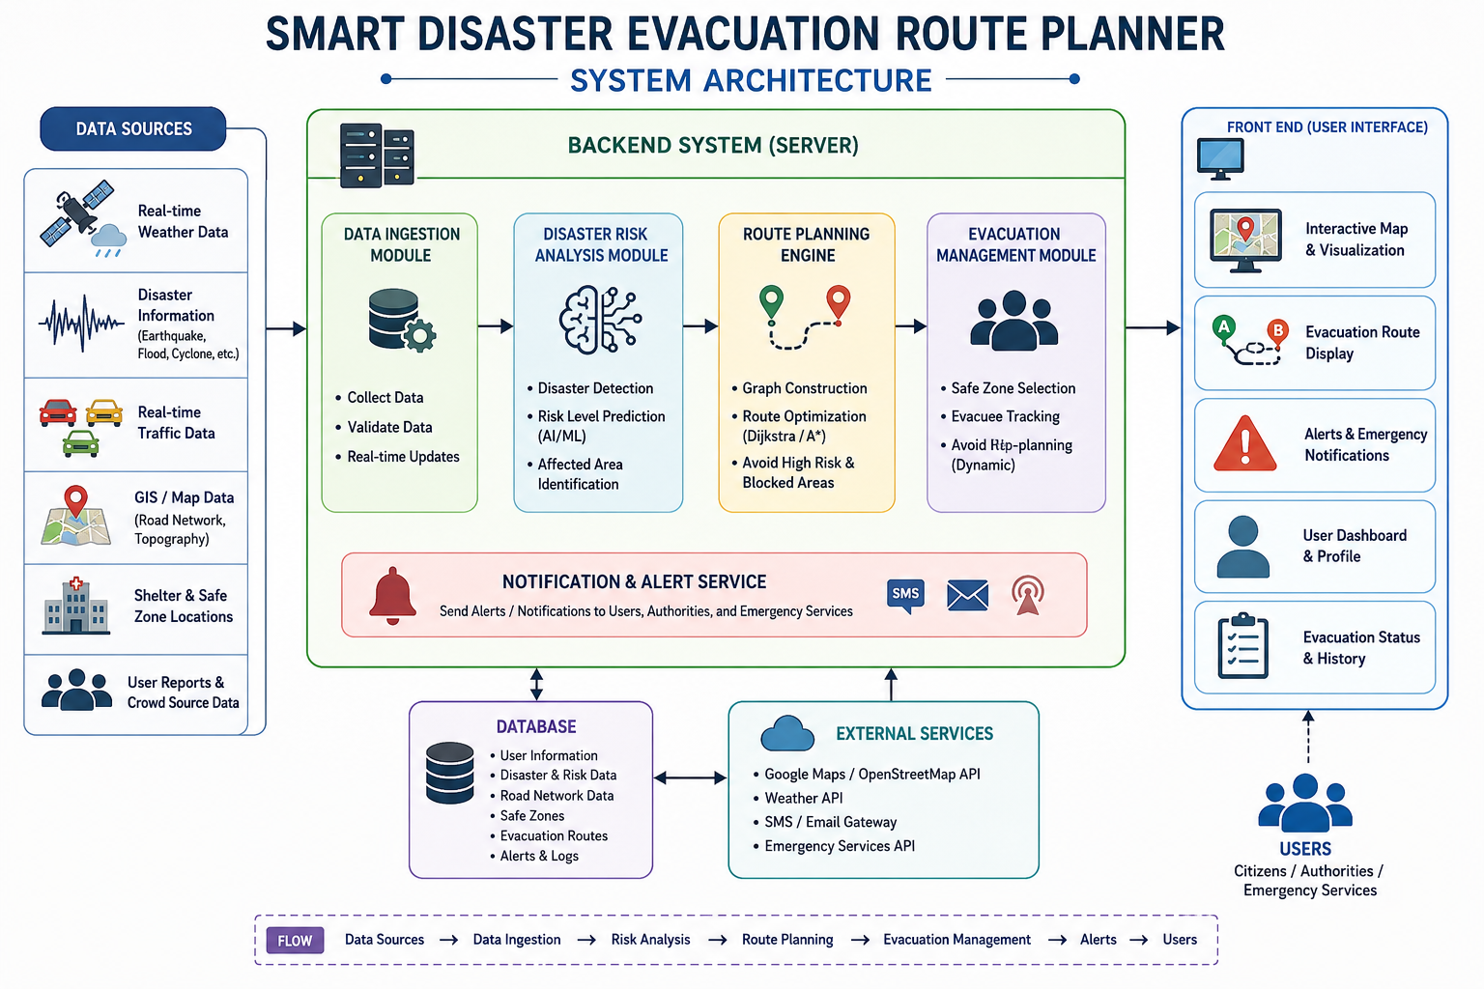

Slide 7

Module 1: Disaster Detection & Risk Analysis
Objective:
To identify disaster-affected areas and determine their risk level.
Key Features:
Real-time disaster data collection
Risk level analysis
Affected area detection Hazard zone mapping

Slide 8
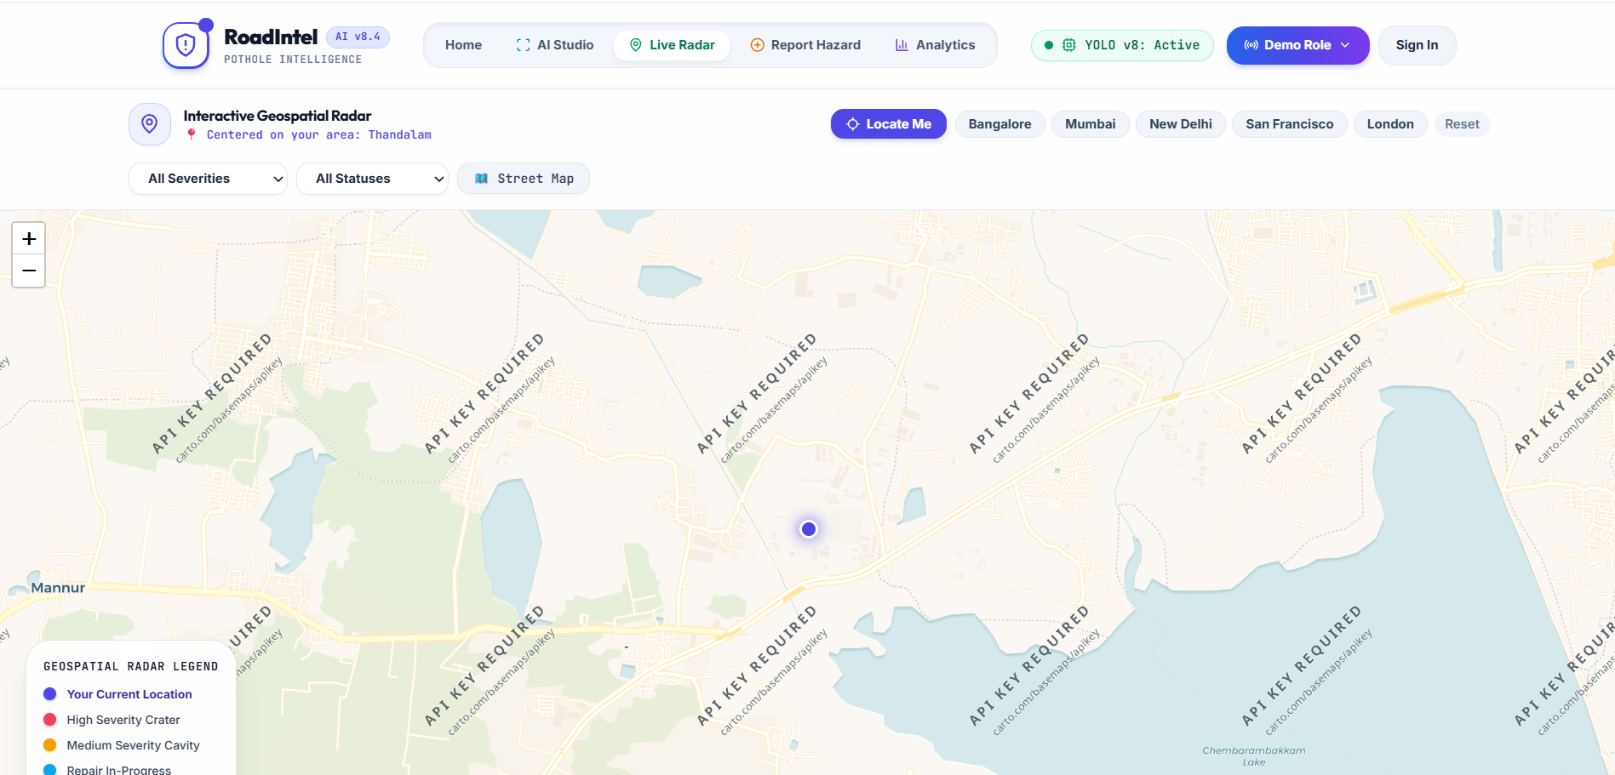
Module 2: Smart Evacuation Route Planning
Objective:
To generate the safest and shortest route to a nearby safe zone.
Key Features:
Safe-zone identification
Dijkstra / A* route optimization
Blocked-road avoidance Dynamic route updates

Slide 9

Module 3: Alert & Evacuation Management
Objective:
To guide users during evacuation and provide timely emergency alerts.
Key Features:
• Emergency notifications • Route guidance • Evacuation status tracking • Authority/emergency service alerts

Slide 10
Future Scope:
Real-Time Safe Route Planning: Automatically identifies the safest and shortest evacuation route based on disaster location, blocked roads, traffic conditions, and available emergency shelters.

Slide 11
Conclusion
The Smart Disaster Evacuation Route Planner helps people identify safe and efficient evacuation routes during disasters.
It considers disaster risk, road blockage, traffic congestion, route safety, and shelter availability while planning routes.
Dynamic route planning can provide better evacuation decisions than relying only on the shortest-path approach.
The system can reduce evacuation time and casualties by directing people away from dangerous or blocked areas.
Real-time and adaptive routing can support emergency responders and disaster-management authorities in making faster decisions.
Overall, the proposed system can improve public safety, evacuation efficiency, and disaster-response management.

Slide 12
References
J. Mao, Y. Zhou, Y. Zhou, and X. Wang, “Urban Emergency Evacuation Path Optimization Based on Uncertain Environments to Enhance Response for Symmetric and Asymmetric Evacuation Problems,” Symmetry, vol. 16, no. 10, Art. no. 1356, Oct. 2024, doi: 10.3390/sym16101356.
M. Yoo, S. Haam, and W. S. Song, “Congestion-Based Earthquake Emergency Evacuation Simulation Model for Underground Structure,” Buildings, vol. 14, no. 10, Art. no. 3217, Oct. 2024, doi: 10.3390/buildings14103217.
M. J. ... et al., “A systematic review of methodologies for human behavior modelling and routing optimization in large-scale evacuation planning,” International Journal of Disaster Risk Reduction, vol. 110, Art. no. 104638, Aug. 2024, doi: 10.1016/j.ijdrr.2024.104638.
“A novel emergency evacuation route optimization model in flood disasters using hydrodynamic model and intelligent algorithm,” Safety Science, vol. 182, Art. no. 106709, Feb. 2025, doi: 10.1016/j.ssci.2024.106709.
“Optimizing evacuation paths using agent-based evacuation simulations and reinforcement learning,” International Journal of Disaster Risk Reduction, vol. 117, Art. no. 105173, Feb. 2025, doi: 10.1016/j.ijdrr.2024.105173.

Slide 13


